Slide 1


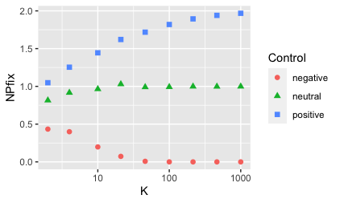
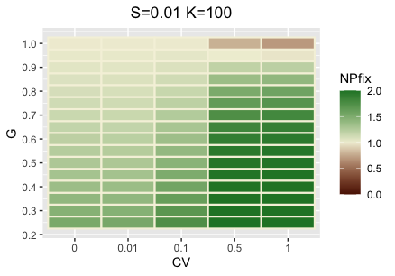
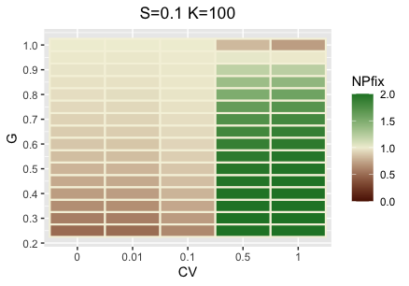
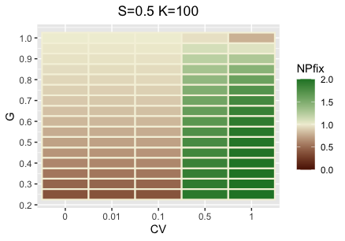
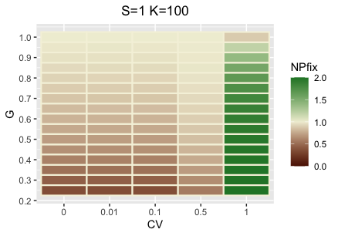
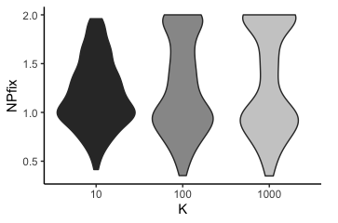
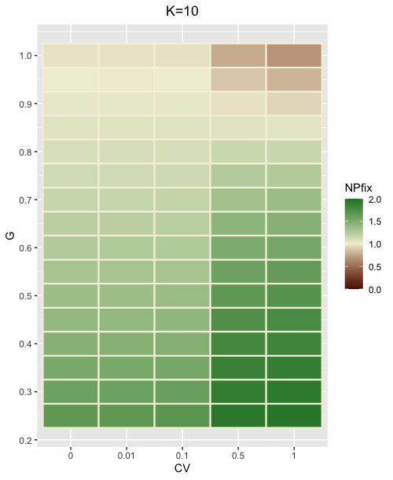
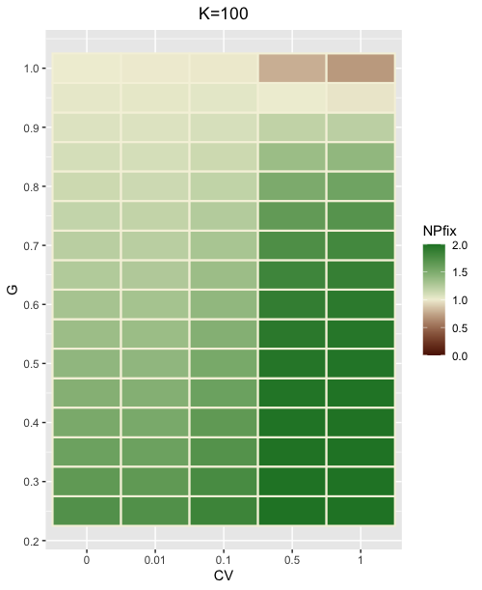
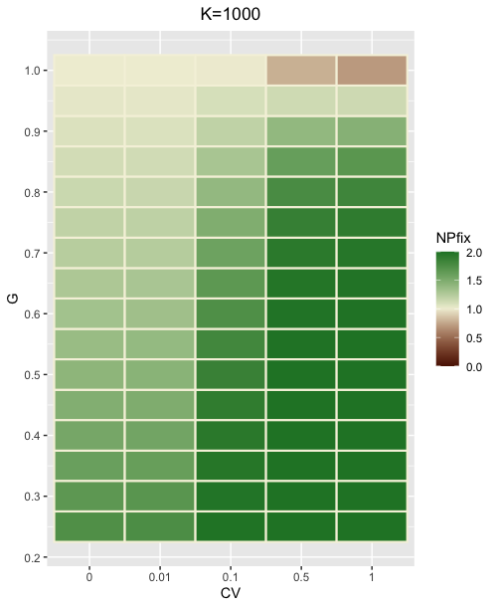
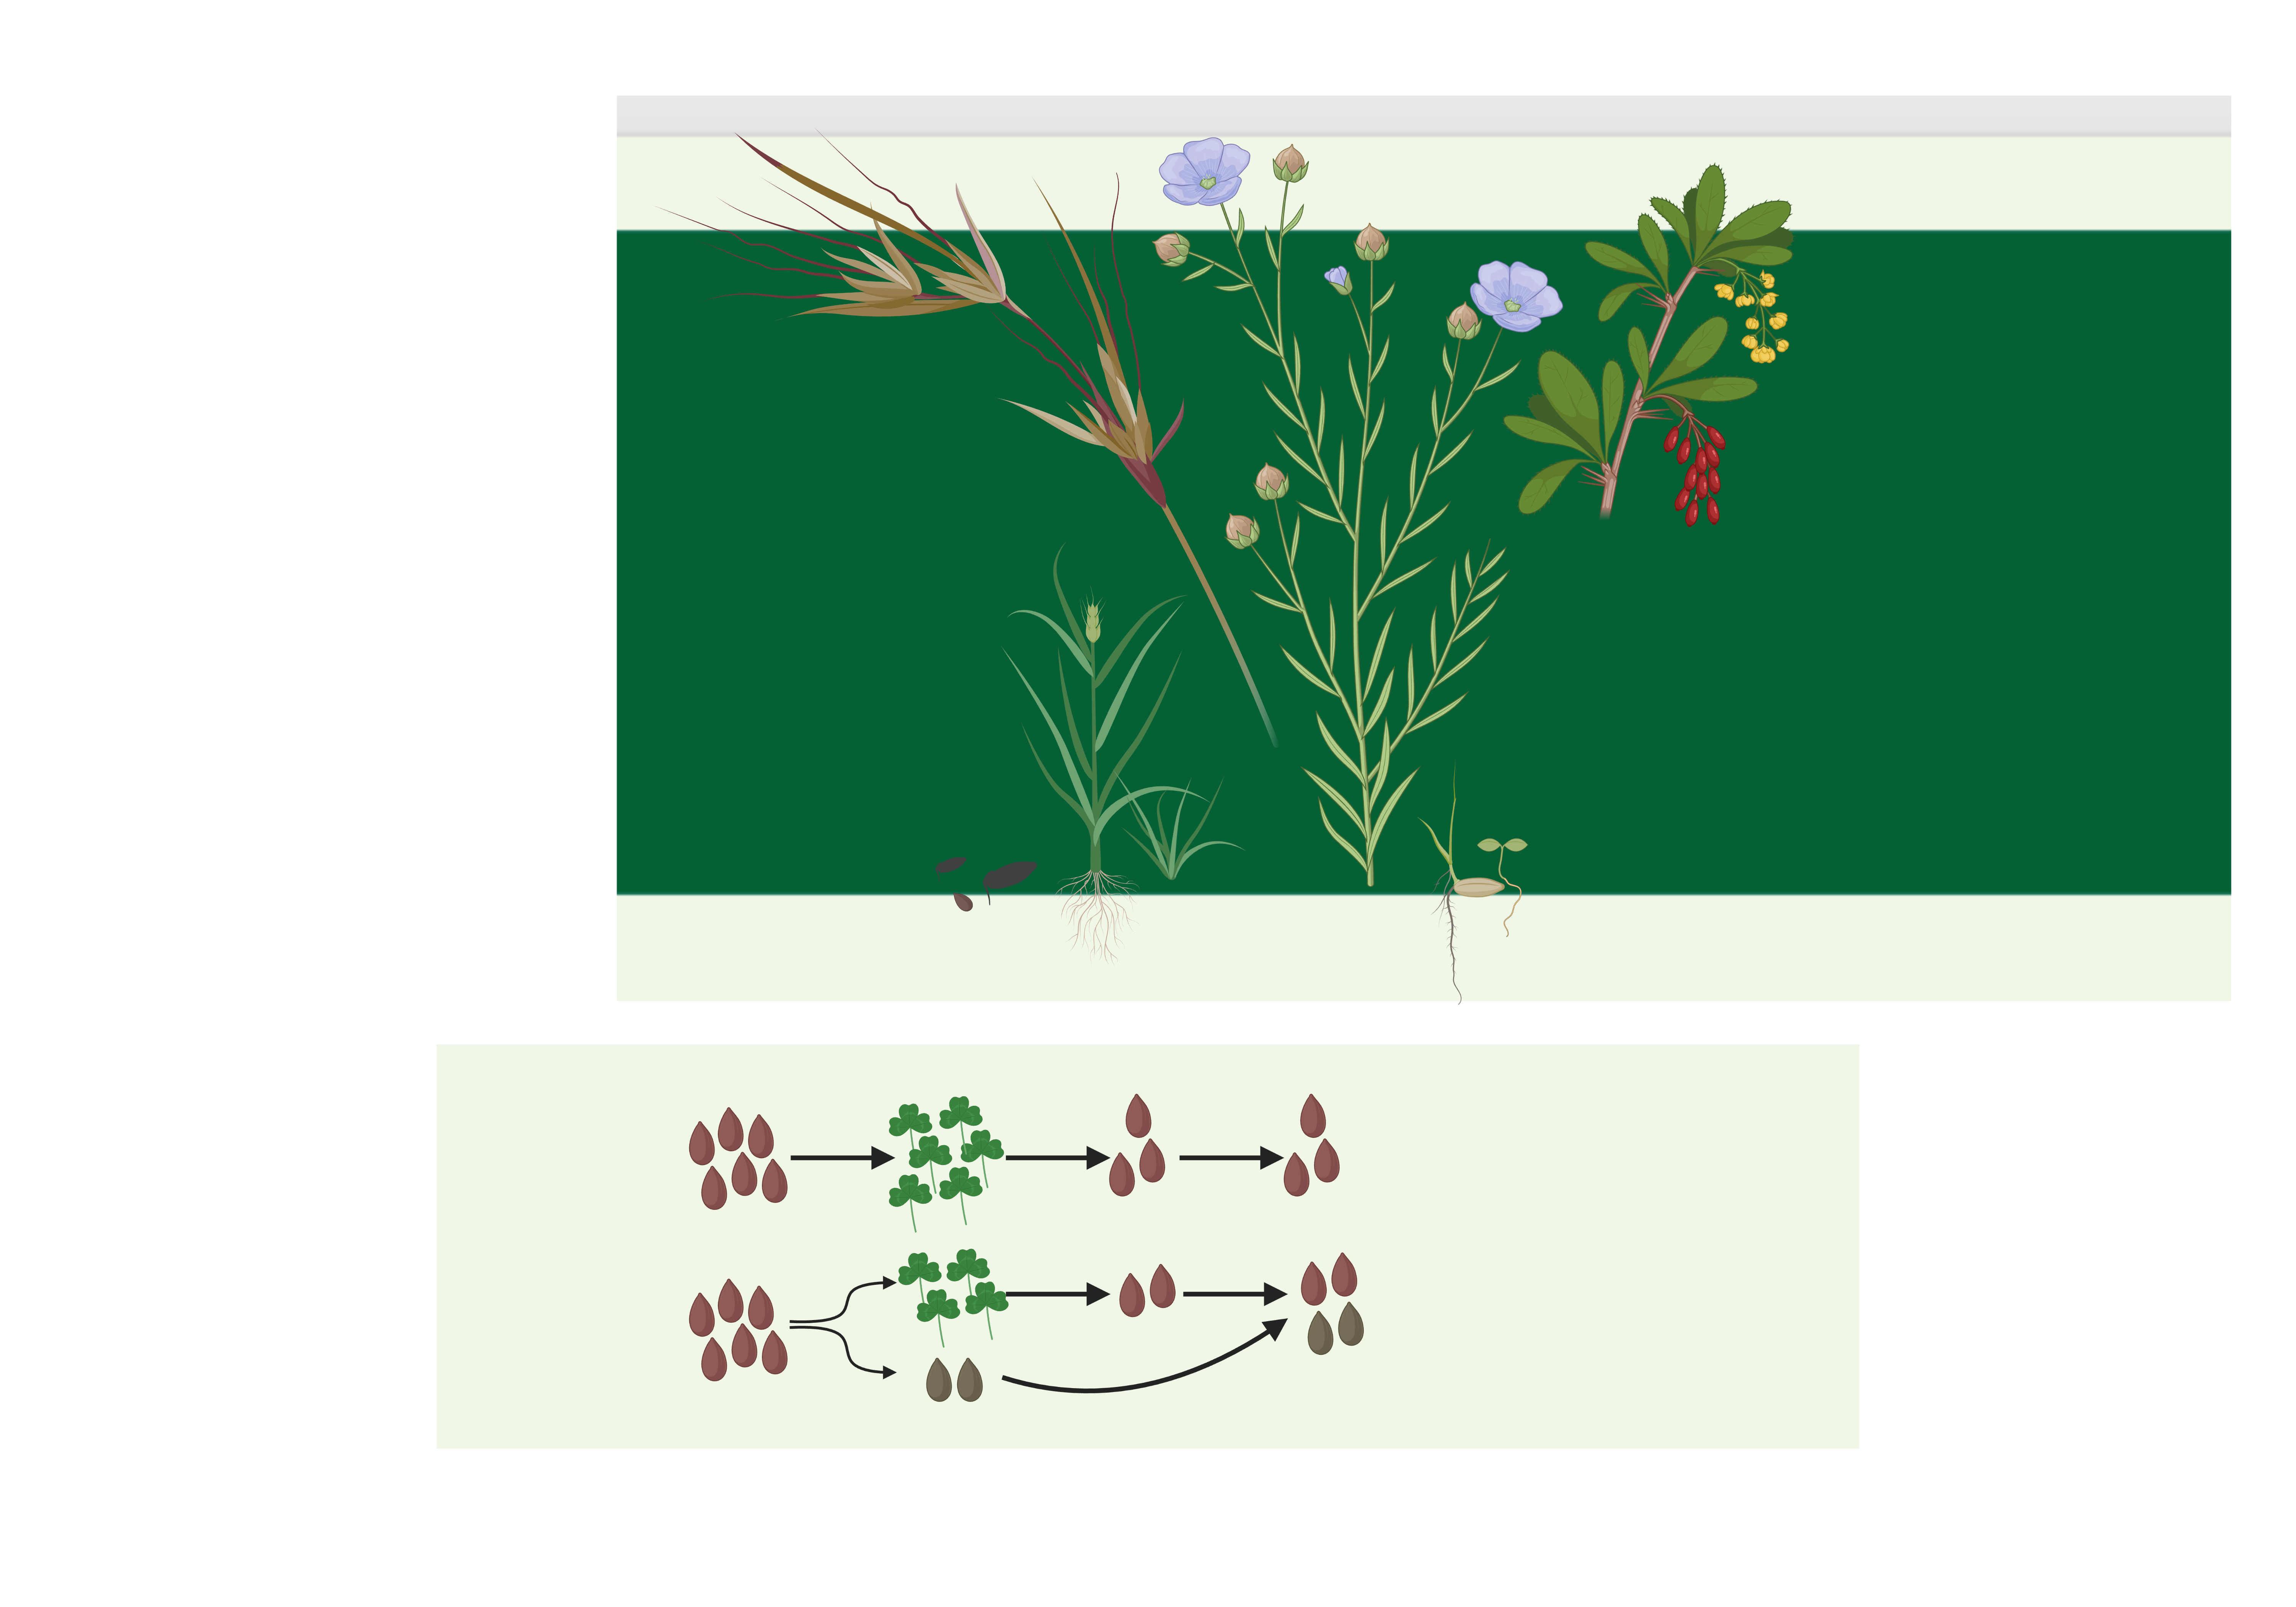

Simulating Bet Hedging Strategies of
Native and Exotic Annual Plants
Department of
Ecology, Evolution and Organismal Biology
Zheng (Neal) Yin, Maya Weissman, Daniel Weinreich | Brown University, RI
Model Validation
Analysis: Selection Coefficient
Background
Organisms need to adapt to a rapidly changing environment to maintain long term survival. One adaptation strategy is bet hedging: sacrificing mean fitness for lower variance in fitness. Annual plants (which produce seeds every year) may bet hedge by delaying seed germination, keeping a portion of new seeds in dormancy instead of letting all germinate in the upcoming year so that those dormant seeds can still germinate after, say, a drought severely reduces the adult population. Inferring how native and exotic annual plants specific to a region hedge their bets through delayed seed germination can shed light onto preservation of native species facing the impact of climate change.
G=0.6, S=0, CV=0.3
G=1.0, S=0, CV=0
G=0.6, S=0, CV=0, seed bank fails
Figure 2. Normalized probabilities of fixation in control sets correspond to expected trends of probabilities of fixation of WT, beneficial, and deleterious mutations as carrying capacity increases (thereby weakening the impact of genetic drift)
Analysis: Carrying Capacity
Method
Figure 3. Normalized probabilities of fixation of bet hedgers (NPfix) at carrying capacities (K) 10, 100, 1000 across ranges of selection coefficient (S) and coefficient of variation (CV) have similar distribution at large K values. However, paired t-test on NPfix among pairs of different K with fixed G, S, and CV show statistically significant difference at α=0.05 among all three pairs, suggesting the carrying capacity of a population does influence the chance of survival for bet hedgers.
We previously aimed to target native & exotic annuals in Rhode Island; however, due to varying collection methods and non-exhaustive coverage on these species, seed germination data are hard to estimate on a consistent scale.
In order to address this gap in knowledge, we use a stochastic model to simulate competition between a wild-type (WT) population and a bet hedging (BH) population of the same initial size within the same species; we calculate the normalized probability of fixation (NPfix) of bet hedgers across all parameter values which serve as indication of adaptivity.
Figure 5. Normalized probabilities of fixation for all other S and K pairs. We see that as selection coefficient increases, the range where bet hedging is adaptive also changes; when K is fixed, the heatmaps display a consistent trend of NPfix decreasing as S increases, suggesting that exotic species tend to be less adaptive when they bet hedge regardless of carrying capacity*.
*[Reproductions with selection coefficients lower than 0.2 simulate native species, those with higher ones exotic]
Discussion
Analysis: Coefficient of Variation
Through simulating the competition between wild type and bet hedging populations, we acquire the normalized probabilities of fixation and can infer that
annual plant bet hedgers are generally more adaptive when the environment is highly variable, and that
exotic annuals are generally less adaptive than natives when they bet hedge.
Heatmaps above along with other statistics not shown enable us to analyze these results in various directions. Meanwhile, the current model can be modified to incorporate real world data and simulate competition of two bet hedgers of different species or the invasion of one single exotic seed into an established native population. Results of these upcoming analyses combined with field data and environmental data will help build a more comprehensive dictionary on the local biodiversity in any region.
year n
adults
new seeds
year n+1
WT
100%
germination
BH
partial
germination
(dormant)
Figure 1. WT and BH generations in simulation
more on model + plots
github.com/nyin01
Parameters
Carrying capacity (K=[10, 100, 1000])
Germination rate (G=[0.25, 0.3, …, 0.95, 1.0])
Selection coefficient (S=[0, 0.01, 0.1, 0.5, 1.0])
Coefficient of Variation (CV=[0, 0.01, 0.1, 0.5, 1.0])
Figure 4. NPfix across all G, K, and CV at S=0(all native species). At all three carrying capacities, heatmaps* exhibit general trends of NPfix increasing as 1) G decreases; and 2) CV increases. We can infer that bet hedgers have a higher chance of survival when more seeds experience delayed germination under a more extremely varying environment.
*[Note that at high germination rates, NPfix should approach 1.0 while the simulation results drop below 1.0 at higher CV values; this results from a design flaw of the model where a simulation ending with extinctions of both populations are tallied up as a WT fixation]
Acknowledgements: we would like to thank the BrownConnect SPRINT UTRA program for providing this opportunity as well as the financial support; we would also like to thank Dr. Rebecca Kartzinel and Dr. Dov Sax for their help and support throughout this project.
References: Olofsson Helen, Ripa Jörgen and Jonzén Niclas 2009Bet-hedging as an evolutionary game: the trade-off between egg size and numberProc. R. Soc. B.2762963–2969 . https://doi.org/10.1098/rspb.2009.0500. https://massnrc.org/mipag/docs/MIPAG_FINDINGS_FINAL_042005.pdf
Created with BioRender.com

